Slide 1
INTRODUCTION TO
PSYCHOLOGY

Slide 2
Chapter 1
INTRODUCTION TO PSYCHOLOGY

Slide 3
CHAPTER 1
What is Psychology?
KEY POINTS
What are the primary perspectives that guide modern Psychology?
What are the career specialties and major sub- fields?

Slide 4


DEFINITION OF PSYCHOLOGY
The scientific study of behavior and mental processes
Behaviour
Mental Processes

Slide 5
PSYCHOLOGY
DESCRIBE
PREDICT
EXPLAIN

Slide 6
ACTIVITY
Most people would refuse to give painful electric shocks to other people.
True or false?
__________
Geniuses generally have poor social adjustment.
True or false?
__________

Slide 7
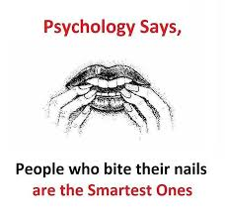

Slide 8
Fields of Psychology
Psychology is a multifaceted discipline
It includes many different approaches to the study of mental processes and behaviour.
According to American Psychological Association (APA)There are following main branches of psychology and their definition.

Slide 9



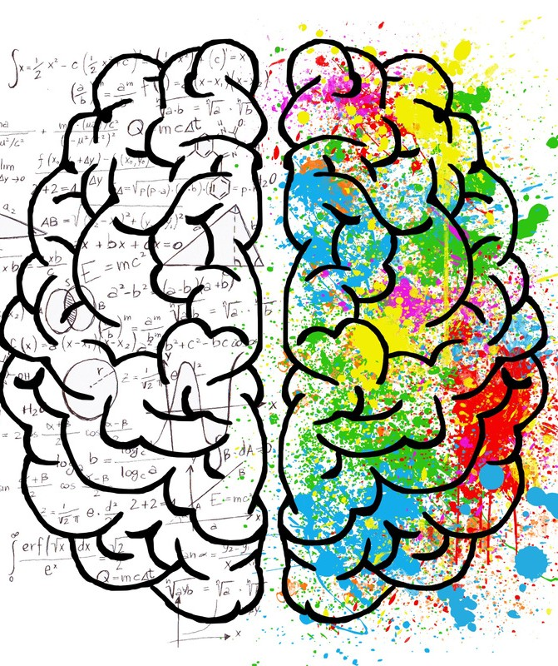
Clinical
Counselling
Educational
Neuro
Sub-fields of Psychology
Notes:
Clinical psychology - specializes in the evaluation, diagnosis, and treatment of mental and behavioral disorders
Counseling psychology - overlaps with clinical, but works with less severe problems
Educational and school psychologists - study the process of education; focus on the intellectual, social, and emotional development of children in the school environment
Neuropsychology - unites the areas of biopsychology and clinical
psychology, focusing on the relationship between biological factors and
psychological disorders.

Slide 10
Clinical Psychology
Clinical psychology
predict and relieve problems with adjustment, disability, and discomfort.
promotes adaption, adjustment, and personal development.
help us to understand, prevent, and alleviate psychologically caused distress or dysfunction, and promote an individual's well-being and personal development.
Psychological assessment and psychotherapy are central to the practice of clinical psychology, but clinical psychologists are often also involved in research, training, forensic testimony, and other areas.

Slide 11
Counselling Psychology
Counselling Psychology:
uses a broad range of culturally-informed and culturally-sensitive practices
to help people improve their well-being, prevent and alleviate distress and maladjustment, resolve crises,
and increase their ability to function better in their lives.

Slide 12
Educational Psychology
Educational Psychology:
provides a collegial environment for psychologists with interest in research, teaching or practice in educational settings at all levels
to present and publish papers about their work.
concerned with theory, methodology and applications to a broad spectrum of teaching, training and learning issues.

Slide 13
Neuro Psychology or Behavioral Neuroscience
Behavioral neuroscience examines the biological basis of behavior in humans and animals.
This discipline typically examines the brain’s neurotransmissions and the psychological events associated with biological activity.

Slide 14




Forensic
School
Sports
Industrial-Organizational
Sub-fields of Psychology
Notes:
Forensic psychology focuses on legal issues, such as determining the
accuracy of witness memories.
Sport psychology applies psychology to athletic activity and exercise.
Industrial/organizational psychology is concerned with the psychology of
the workplace.

Slide 15
School Psychology
concerned with children, youth, families, and the schooling process.
school psychologists are prepared to intervene at the individual and system levels, and develop, implement and evaluate programs
to promote positive learning environments for children and youth from diverse backgrounds,
and to ensure equal access to effective educational and psychological services that promote health development.

Slide 16
Forensic Psychology
Forensic psychology focuses on legal issues, such as determining the accuracy of witness memories.
Deals with clinical spectrum within a legal context that may result in civil and criminal legal questions that courts must ultimately decide

Slide 17
Sports Psychology
study of how psychological factors influence sports, athletic performance, exercise, and physical activity.
help athletes utilize psychology to improve their athletic performance and mental wellness.
also helps non-athletes and everyday exercisers learn how to enjoy sports and stick to an exercise program.

Slide 18
Industrial Organizational Psychology
study of human behavior in organizations and the workplace.
focuses on principles of individual, group and organizational behavior and applying this knowledge to the solution of problems at work.
addresses issues of recruitment, selection and placement, training and development, performance measurement, workplace motivation and reward systems, quality of work life, structure of work and human factors, organizational development and consumer behavior.

Slide 19




Social
Environmental
Experimental
Health
Sub-fields of Psychology
Notes:
Social psychology is the study of how people’s thoughts, feelings, and
actions are affected by others.
Environmental psychology considers the relationship between people and
their physical environment.
Experimental psychology studies the processes of sensing, perceiving,
learning, and thinking about the world.
Health psychology explores the relationship between psychological
factors and physical ailments or disease.

Slide 20
Social Psychology
to understand and explain how the thoughts, feelings, and behavior of individuals are influenced by the actual, imagined, or implied the presence of other human beings.
understanding how each person's individual behavior is influenced by the social environment in which that behavior takes place.

Slide 21
Environmental Psychology
examines the relationship between human beings and our surroundings.
It considers how we as people shape our natural world and built environments – and how those environments shape us in turn.
studies the relationships between living organisms and their environments, environmental psychology also considers how we as people affect the world.

Slide 22
Experimental Psychology
interested in exploring theoretical questions, often by creating a hypothesis and then setting out to prove or disprove it through experimentation.
study a wide range of behavioral topics among humans and animals, including sensation, perception, attention, memory, cognition and emotion.
use scientific methods to collect data and perform research.

Slide 23
Health Psychology
focuses on how biology, psychology, behavior, and social factors influence health and illness.
focused on promoting health as well as the prevention and treatment of disease and illness.
also focus on understanding how people react to, cope with, and recover from illness.

Slide 24

ACADEMIC FIELDS
MEDICAL/ HEALTH
BUSINESS FIELDS
SOCIAL FIELDS
WHERE DO PSYCHOLOGISTS WORK?

Slide 25
PSYCHOLOGICAL PERSPECTIVES
STRUCTURALISM
FUNCTIONALISM BEHAVIORISM
HUMANISTIC EVOLUTIONARY
PSYCHODYNAMIC
COGNITIVE
GESTALT NEUROSCIENCE SOCIOCULTURAL

Slide 26
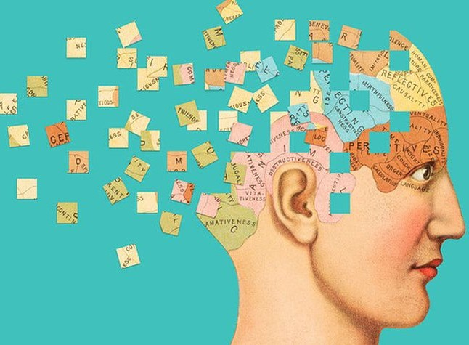
STRUCTURALISM: Building blocks of mind
Wilhelm Wundt
Structuralism is the study of the most basic elements, primarily sensations and perceptions, that make up our conscious mental experiences.
Study of conscious experience. Introspection was a method of exploring conscious mental processes by asking subjects to look inward and report their sensations and perceptions.
Notes:
Focused on uncovering the fundamental mental components of perception, consciousness, thinking, emotions, and other mental states and activities.

Slide 27

FUNCTIONALISM
William James
They studied how and why the mind functions.
Examined how people satisfy their needs through their behavior.
How the flow of thoughts in our conscious minds—permits us to adapt to our environment.

Slide 28
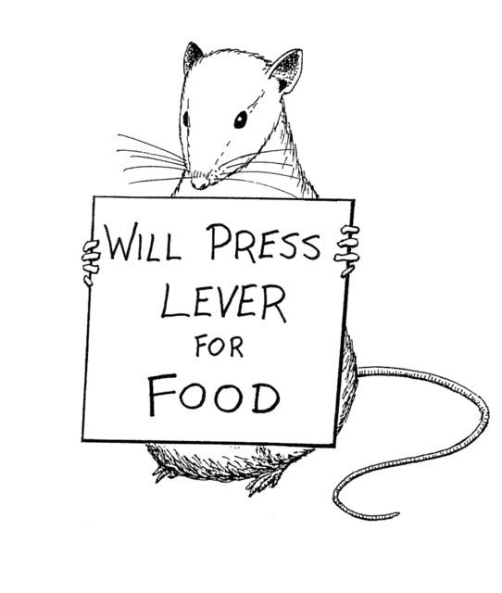
BEHAVIORISM
The behavioral approach emphasized the objective, scientific analysis of observable behaviors.
We can describe, predict, and control that behavior.
John B. Watson
suggests that the focus should be on observable behavior that can be measured
objectively.
Skinner, Pavlov

Slide 29
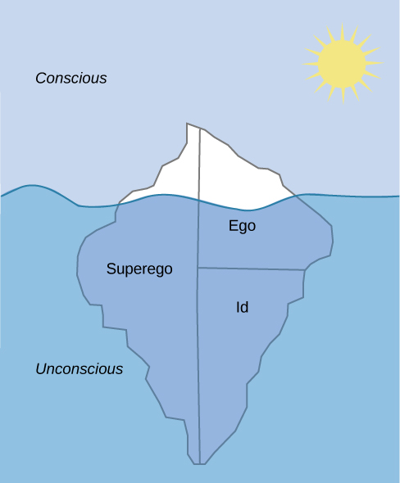
PSYCHODYNAMIC
Emphasizes unconscious processes and early life or childhood experiences motivated by inner forces and conflicts about which we have little awareness or control.
Free association and dream interpretation were developed technique to explore the unconscious processes
Sigmund Freud
Notes:
They view dreams and slips of the tongue
as indications of what a person is truly feeling within a seething cauldron of unconscious
psychic activity.
The origins of the psychodynamic view are linked to one person: Sigmund
Freud.

Slide 30
Think on your own… Do childhood experiences affect adult life?

Slide 31
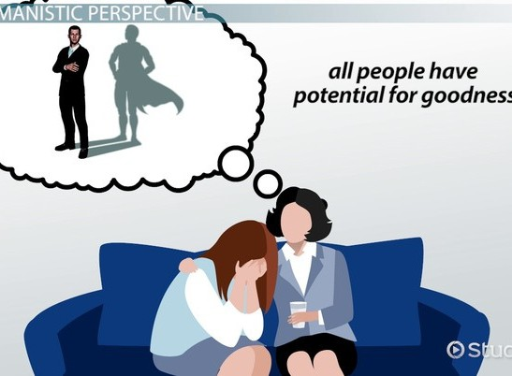
HUMANISTIC
Suggests that all individuals naturally strive to grow, develop, and be in control of their lives and behavior.
The fundamental belief of humanistic psychology was that people are innately good.
We are not rats in a cage! We are not id-driven animals! We are humans with free will.
Carl Rogers Abraham Maslow
Notes:
Humanistic psychologists maintain that each of us has the
capacity to seek and reach fulfillment

Slide 32

COGNITIVE
Focuses on how people think, understand, and know about the world.
compare human
thinking to the workings of a computer,

Slide 33
Cont.
Cognitive psychology believes that behaviors are performed because of ideas and thoughts.
The cognitive perspective focuses on such processes as perception, memory, and thinking.
How people perceive, remember, think, speak, and solve problems.

Slide 34
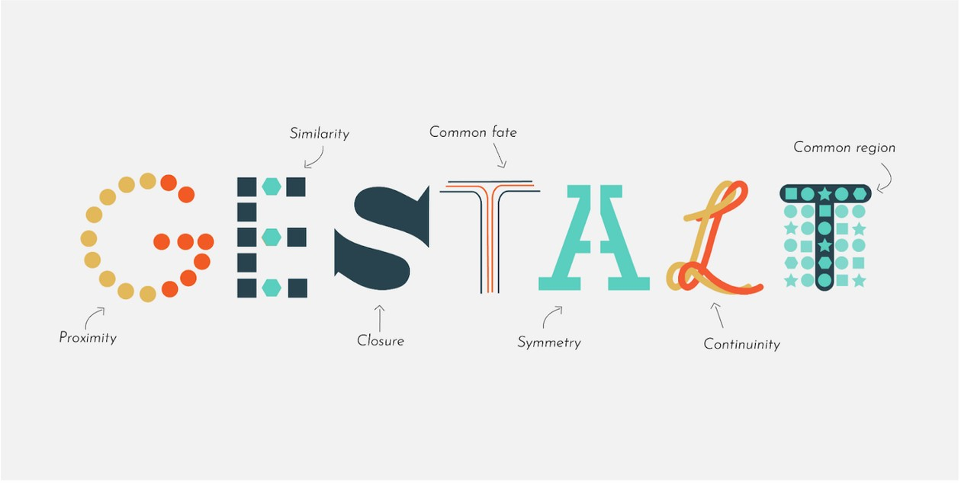
GESTALT
Hermann Ebbinghaus and Max Wertheimer
Emphasizes how perception is organized.
Gestalt psychologists study how people consider individual elements together as units or wholes.
The Gestalt approach emphasized that perception is more than the sum of its parts and studied how sensations are assembled into meaningful perceptual experiences.

Slide 35
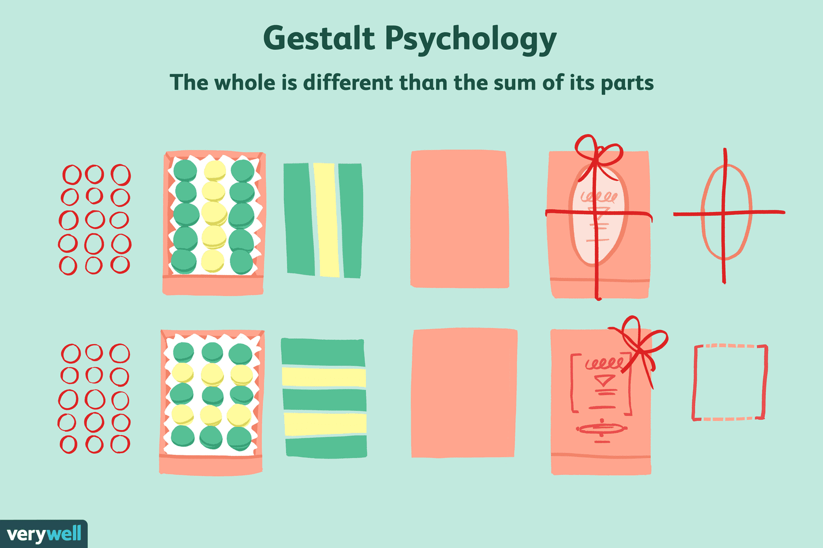

Slide 36

NEUROSCIENCE
Views behavior from the perspective of biological functioning.
How individual nerve cells are joined together, Inheritance of certain characteristics from parents and other ancestors influence behavior,
Functioning of nervous system

Slide 37

EVOLUTIONARY
Evolutionary psychology considers how behavior is influenced by our genetic inheritance from our ancestors.
Charles Darwin
They argue that our genetic inheritance determines not only physical traits such as skin and eye color but certain personality traits and social behaviors as well. For example, evolutionary psychologists suggest that behavior such as shyness, jealousy

Slide 38

SOCIOCULTURAL
Focuses on social interactions and cultural determinants

Slide 39


